Slide 1

Object Oriented Structural modeling
Static UML Design
Chapter Seven

Slide 2
Outline
Class diagram
Object diagram
Collaboration diagram
Architectural design

Slide 3
Structure Diagrams
Class Diagram
Describe the structure of the system in terms of classes and objects
Primary purpose during analysis workflow
to create a vocabulary that is used by both the analyst and users

Slide 4
Discovering Classes
CRC Card
A simple object-oriented analysis technique that includes the users and developers in the analysis process
A CRC card is an index card with three parts:
Class -- name goes at the top of the card
Responsibilities -- as a list on the left side of the card
Collaborators -- as a list on the right side of the card
Class Name
Responsibilities | Collaborators

Slide 5
CRC
Class
Represents a type of object being modeled
One card per class
Responsibility
Something that the class knows (keeps track of) or does
These should be the high-level responsibilities.
Not trying to list out all member functions here
Collaborator
Another class that the current class has to work with to complete its responsibilities
Could be a class that has information we need
Could be a class that helps perform a task
Typically, we list a class as a collaborator if we (the current class) need to call upon it to help complete our own responsibilities

Slide 6
Discovering Classes (Alternative)
Underline the nouns in a problem statement.
Using the problem context and general knowledge about the problem domain decide on the important nouns.
Design and implement classes to represent the nouns.
Underline the verbs.
Verbs related to a class may represent the behavior of the class.

Slide 7
Class Naming Rule
A class name must always be either:
A noun, possibly qualified.
(Only for a deferred class describing a structural property) an adjective.
Names of classes are written with an initial capital letter
(like this: Button, not like this: button) and have no spaces.
To show where a space would be, the next letter is capitalized (like this: BarcodeReader, not like this: Barcode Reader).
Class names are singular, not plural.
It is incorrect to name a class “Books”.
Although there may be many book objects, there is only one book class.
Names of attributes and operations start with a lower-case letter, but may have capital letters to indicate where the spaces would be, if the name would normally have spaces.
Names of operations are followed by brackets () to distinguish them from names of attributes

Slide 8
Class
A class is a description of a set of objects that share the same attributes, operations, relationships, and semantics.
Graphically, a class is rendered as a
rectangle, usually including its name, attributes, and operations in separate, designated compartments.
ClassName
attributes
operations

Slide 9
Class Names
ClassName
The name of the class is the only required tag in the graphical representation of a class. It always appears in the top-most compartment.
Underline if the class is static class
attributes
operations

Slide 10
Class Attributes
Person
name : String
address : Address
birthdate : Date
ssn : Id
An attribute is a named property of a class that describes the object being modeled.
In the class diagram, attributes appear in the second compartment just below the name-compartment.

Slide 11
Class Attributes …
Attributes are usually listed in the form:
Visibility attributeName : Type
A derived attribute is one that can be computed from other attributes, but doesn’t actually exist.
For example,
a Person’s age can be computed from his birth date. A derived attribute is designated by a preceding ‘/’ as in:
/ age : Date
Person
name : String
address : Address
birthdate : Date
/ age : Date
ssn : Id

Slide 12
Class Attributes …
Person
+ name : String
# address : Address
# birthdate : Date
/ age : Date
- ssn : Id
Attributes can be:
+ public
# protected
- private
/ derived

Slide 13
Class Operations
Person
name : String
address : Address
birthdate : Date
ssn : Id
Operations describe the class behavior and appear in the third compartment.
eat
sleep
work
play

Slide 14
Class Operations …
PhoneBook
newEntry (n : Name, a : Address, p : PhoneNumber, d : Description)
getPhone ( n : Name, a : Address) : PhoneNumber
Visibility nameMethod(parameterName:dataType) : dataTypeforMethod
You can specify an operation by stating its signature: listing the name, type, and default value of all parameters, and, in the case of functions, a return type.

Slide 15
Depicting Classes
When drawing a class, you needn’t show attributes and operation in every diagram.
Person
Person
Person
name : String
birthdate : Date
ssn : Id
Person
name
address
birthdate
eat()
sleep()
work()
play()
Person
eat
play

Slide 16
Relationships
In UML, object interconnections (logical or physical), are modeled as relationships.
There are Four kinds of relationships in UML Class diagram:
Associations
Dependencies
Generalizations
Realization

Slide 17
Association
If two classes in a model need to communicate with each other, there must be link between them.
An association denotes that link.
Student
Instructor

Slide 18
Association …
We can indicate the multiplicity of an association by adding multiplicity adornments to the line denoting the association.
The example indicates that a Student has one or more Instructors:
Student
Instructor
1..*

Slide 19
Association …
The example indicates that every Instructor has one or more Students:
Student
Instructor
1..*

Slide 20
Association …
We can also indicate the behavior of an object in an association (i.e., the role of an object) using rolenames.
teaches
learns from
Student
Instructor
1..*
1..*

Slide 21
Association …
We can also name the association.
membership
Student
Team
1..*
1..*

Slide 22
Association …
We can specify dual associations.
member of
Student
Team
1..*
1..*
1
president of
1..*

Slide 23
Association …
We can constrain the association relationship by defining the navigability of the association.
Here, a Router object requests services from a DNS object by sending messages to (invoking the operations of) the server.
The direction of the association indicates that the server has no knowledge of the Router.
Router
DomainNameServer

Slide 24
Association …
Associations can also be objects themselves, called link classes or an association classes.
Registration
modelNumber
serialNumber
warrentyCode
Product
Warranty

Slide 25
Association …
A class can have a self association.
next
LinkedListNode
previous

Slide 26
Association …
Aggregation
specifies a whole-part relationship between an aggregate (a whole) and a constituent part, where the part can exist independently from the aggregate. Aggregations are denoted by a hollow-diamond adornment on the association.
Car
Engine
Transmission

Slide 27
Association …
Composition
indicates a strong ownership and coincident lifetime of parts by the whole (i.e., they live and die as a whole). Compositions are denoted by a filled-diamond adornment on the association.
Window
Scrollbar
1
1
Titlebar
1
1
Menu
1
1 .. *

Slide 28
Dependency
Dependency
indicates a semantic relationship between two or more elements.
The dependency from CourseSchedule to Course exists because Course is used in both the add and remove operations of CourseSchedule.
CourseSchedule
Course
add(c : Course)
remove(c : Course)

Slide 29
Generalization
A generalization connects a subclass to its superclass.
It denotes an inheritance of attributes and behavior from the superclass to the subclass and indicates a specialization in the subclass of the more general superclass.
Person
Student

Slide 30
Generalization
UML permits a class to inherit from multiple super classes, although some programming languages (e.g., Java) do not permit multiple inheritance.
Student
Employee
TeachingAssistant

Slide 31
Types of Classes
Entity classes
Interface or Boundary classes
Abstract classes
Control classes
10-31

Slide 32
Entity Classes
Represent real-world items
Such as people, thing and so on
The entities represented on an entity-relationship diagram

Slide 33
Interface or Boundary Classes
Provide a means for users to work with the system
Human interfaces may be a display, window, Web form, dialogue box, touch-tone telephone, or other way for users to interact with the system
System interfaces involve sending data to or receiving data from others
The attributes of these classes are those found on the display or report.
The methods are those required to work with the display, or produce the report.

Slide 34
Abstract Classes
Linked to concrete classes in a generalization/ specialization relationship
Cannot be directly instantiated
<<Abstract>>
Shape
int x;
Int y
Draw(x,y)
Shape
int x;
Int y
Draw(x,y)

Slide 35
Control Classes
Used to control the flow of activities
Many small control classes can be used to achieve classes that are reusable
The rules for creating sequence diagrams are that all interface classes must be connected to a control class and in a similar fashion all entity classes must be connected to a control class.

Slide 36
Four rules apply to their communication
Actors can only talk to boundary objects.
Boundary objects can only talk to controllers and actors.
Entity objects can only talk to controllers.
Controllers can talk to boundary objects and entity objects, and to other controllers, but not to actors

Slide 37
Example
Multiplicity
Customer
1
Simple
Aggregation
Class
Abstract
Class
Rental Invoice
Rental Item
1..*
1
0..1
Composition
Simple
Association
Generalization
Checkout Screen
DVD Movie
VHS Movie
Video Game

Slide 38
Exercise
Draw a UML Class Diagram representing the following elements from the problem domain for a soccer league.
A soccer league is made up of at least four soccer teams. Each soccer team is composed of eleven players, and one player captains the team. A team has a name and a record. Players have a number and a position. Soccer teams play games against each other. Each game has a score and a location. Teams are sometimes lead by a coach. A coach has a level of accreditation and a number of years of experience, and can coach multiple teams. Coaches and players are people, and people have names and addresses.

Slide 39
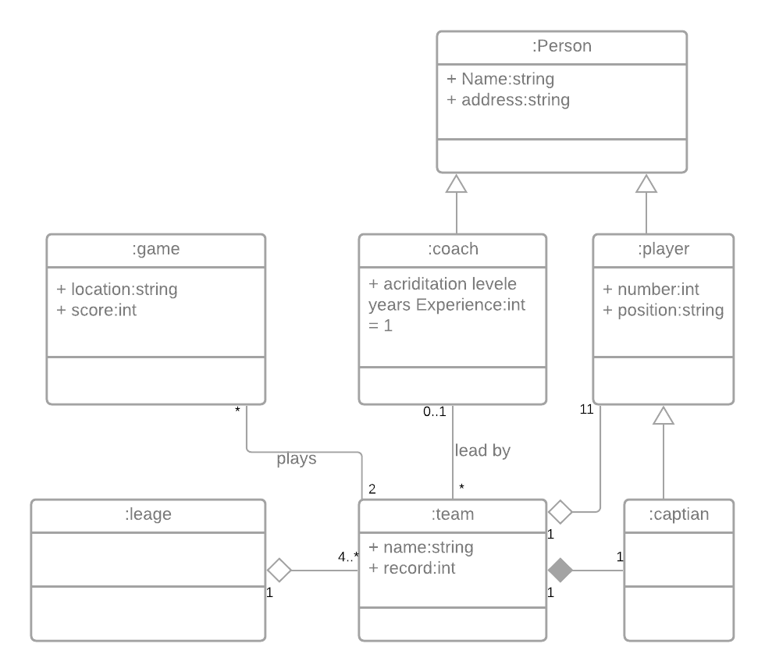
Possible answer

Slide 40
UML Object Diagram

Slide 41
Introduction
Object diagrams represent an instance of a class diagram.
The basic concepts are similar for class diagrams and object diagrams.
Object diagrams also represent the static view of a system but this static view is a snapshot of the system at a particular moment.
Object diagrams are used to render a set of objects and their relationships as an instance.

Slide 42
Purpose of Object Diagram
But an object diagram represents an instance at a particular moment which is concrete in nature.
It means the object diagram is more close to the actual system behavior. The purpose is to capture the static view of a system at a particular moment.
So the purpose of the object diagram can be summarized as:
Forward and reverse engineering.
Object relationships of a system
Static view of an interaction.
Understand object behavior and their relationship from practical perspective

Slide 43
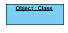
Basic Object Diagram Symbols and Notations
Object Names:
Every object is actually symbolized like a rectangle, that offers the name from the object and its class underlined as well as divided with a colon.

Slide 44
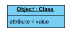
Basic Object Diagram Symbols and Notations …
Object Attributes:
Similar to classes, you are able to list object attributes inside a separate compartment. However, unlike classes, object attributes should have values assigned for them.

Slide 45
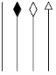
Basic Object Diagram Symbols and Notations
Links:
Links tend to be instances associated with associations. You can draw a link while using the lines utilized in class diagrams.

Slide 46
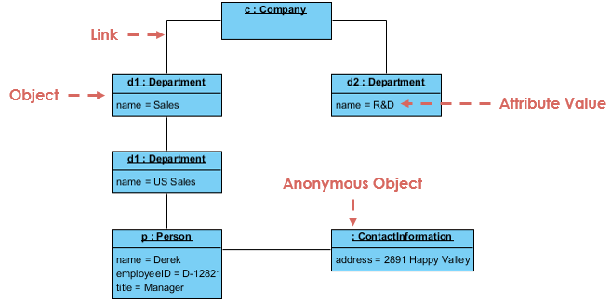
Example 1

Slide 47
Class Vs Object Diagram
Both diagrams are made of same basic elements but in different form.
In class diagram elements are in abstract form to represent the blue print and in object diagram the elements are in concrete form to represent the real world object.
To capture a particular system, numbers of class diagrams are limited. But if we consider object diagrams then we can have unlimited number of instances which are unique in nature.

Slide 48
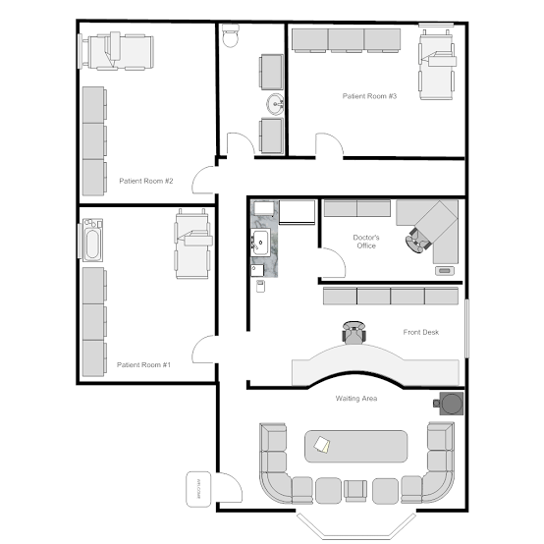
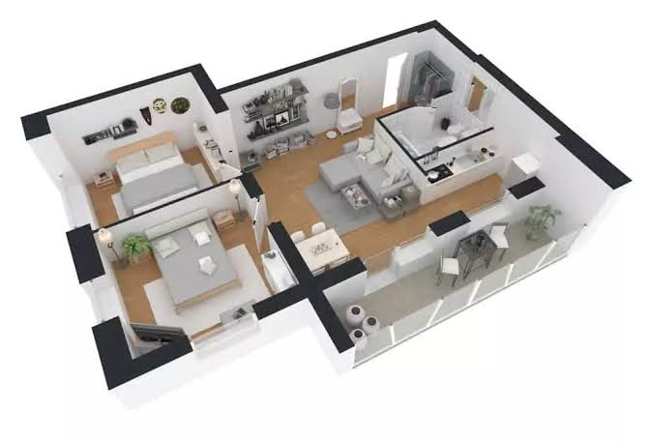
Class Vs Object Diagram …

Slide 49
Class Vs Object Diagram …
Class are become live when objects are created from them
Object diagrams use notation that is similar to that used in class diagrams.
Class diagrams show the actual classifiers and their relationships in a system
Object diagrams show specific instances of those classifiers and the links between those instances at a point in time.
You can create object diagrams by instantiating the classifiers in class, deployment, component, and use-case diagrams.

Slide 50
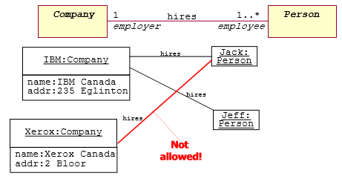
Example 2

Slide 51
Collaboration Diagrams

Slide 52
What is a Collaboration Diagram
Collaboration diagrams illustrate interactions between objects
The collaboration diagram illustrates messages being sent between classes and objects (instances).
Collaboration diagrams express both the context of a group of objects (through objects and links) and the interaction between these objects (by representing message broadcasts)

Slide 53
Purpose of the Collaboration Diagram
They are very useful for visualizing the relationship between objects collaborating to perform a particular task
They provide a good view – although static - view of interaction between objects which may be difficult to see at the class level

Slide 54
Collaboration Diagram
Represents a Collaboration and Interaction
Collaboration­ set of objects and their interactions in a specific context
Interaction­ set of messages exchanged in a collaboration to produce a desired result

Slide 55
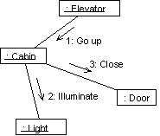
Ex. Collaboration Diagram

Slide 56
Collaboration Diagram Elements
There are three primary elements of a collaboration diagram:
Objects
Links
Messages

Slide 57
Collaboration Diagram Syntax
AN ACTOR
AN OBJECT
AN ASSOCIATION
A MESSAGE
anObject:aClass
aMessage()

Slide 58
Objects
Objects­ rectangles containing the object signature­ :
object name : object Class
object name (optional) - starts with lowercase letter
class name (mandatory) - starts with uppercase letter
Objects connected by lines­ actor can appear

Slide 59
Objects
Objects participating in a collaboration come in two flavors—supplier and client
Supplier objects are the objects that supply the method that is being called, and therefore receive the message
Client objects call methods on supplier objects, and therefore send messages.

Slide 60
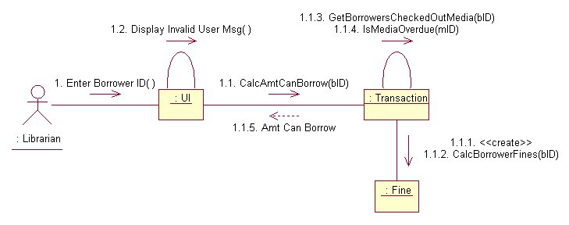
transaction object acts as a supplier to the UI (user interface) client object. in turn, the fine object is a supplier to the transaction client object.

Slide 61
Links
The connecting lines drawn between objects are links
They enable you to see the relationships between objects
This symbolizes the ability of objects to send messages to each other
A single link can support one or more messages sent between objects

Slide 62
The visual representation of a link is a straight line between two objects.
If an object sends messages to itself, the link carrying these messages is represented as a loop icon.
This loop can be seen on both the UI object and the Transaction object.

Slide 63
Messages
An interaction is implemented by a group of objects that collaborate by exchanging messages
Messages in collaboration diagrams are shown as arrows pointing from the Client object to the Supplier object.
Typically, messages represent a client invoking an operation on a supplier object

Slide 64
Messages
Message icons have one or more messages associated with them
Messages are composed of message text prefixed by a sequence number
Time is not represented explicitly in a collaboration diagram, and as a result the various messages are numbered to indicate the sending order

Slide 65
Flow by Numbers
1. Enter Borrower ID
1.1 CalcAmtCanBorrow
1.1.1 <<create>>
1.1.2 CalcBorrowerFines
1.1.3 GetBorrowersCheckedOutMedia
1.1.4 IsMediaOverdue
1.1.5 Amt Can Borrow
1.2 Display Invalid User Msg

Slide 66
Message Flow Notation
Synchronous
Flow of control
Asynchronous
Return

Slide 67
Iterating Messages
Collaboration diagrams use syntax similar to sequence diagrams to indicate that either a message iterates (is run multiple times) or is run conditionally
An asterisk (*) indicates that a message runs more than once
Or the number of times a message is repeated can be shown by numbers (for example, 1..5)

Slide 68
Conditional Messages
To indicate that a message is run conditionally, prefix the message sequence number with a conditional [guard] clause in brackets [ x = true ]:
[IsMediaOverdue ]
This indicates that the message is sent only if the condition is met

Slide 69
Collaboration vs Sequence Diagram
In reality, sequence diagrams and collaboration diagrams show the same information, but just present it differently
Not used as often as sequence diagrams but are closely related

Slide 70
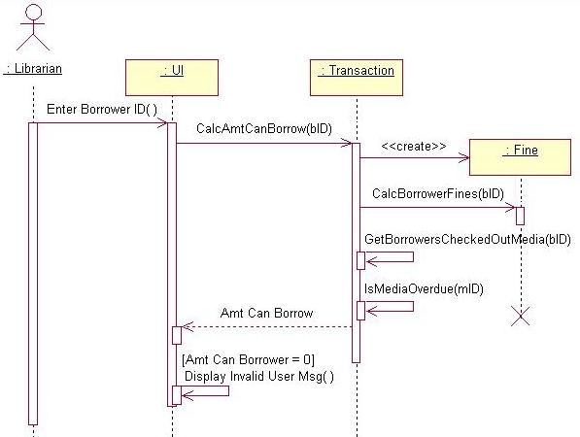
Sequence diagram is better at ‘time ordering’

Slide 71
Collaboration diagram is better at showing the relationship between objects

Slide 72
Number of Messages
In sequence diagrams, each message icon represents a single message.
In collaboration diagrams, a message icon can represent one or more messages.
Notice between the Transaction and Fine objects - there is a single message icon, but there are two messages (1.1.1 and 1.1.2) associated with the icon.

Slide 73
Steps to Creating a Collaboration Diagram
Determine the scope of the diagram- the use case it relates to
Place the objects that participate in the collaboration on the diagram
Remember to place the most important objects towards the center of the diagram.
If a particular object has a property or maintains a state that is important to the collaboration, set the initial value of the property or state

Slide 74
Steps to Creating a Collaboration Diagram
Create links between the objects
Create messages associated with each link
Add sequence numbers to each message corresponding to the time-ordering of messages in the collaboration

Slide 75
Creation and Deletion
Unlike sequence diagrams, you don't show an object's lifeline in a collaboration diagram
If you want to indicate the lifespan of an object in a collaboration diagram, you can use create and destroy messages to show when an object is instantiated and destroyed

Slide 76
Objects Changing State
State of on object can be indicated
Initial state is indicated with <<create>>
If an object changes significantly during an interaction, you can add a new instance of the object to the diagram, draw a link between them and add a message with the stereotype <<become>>

Slide 78
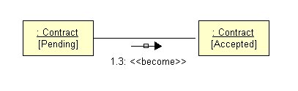
Change State of an Object

Slide 79
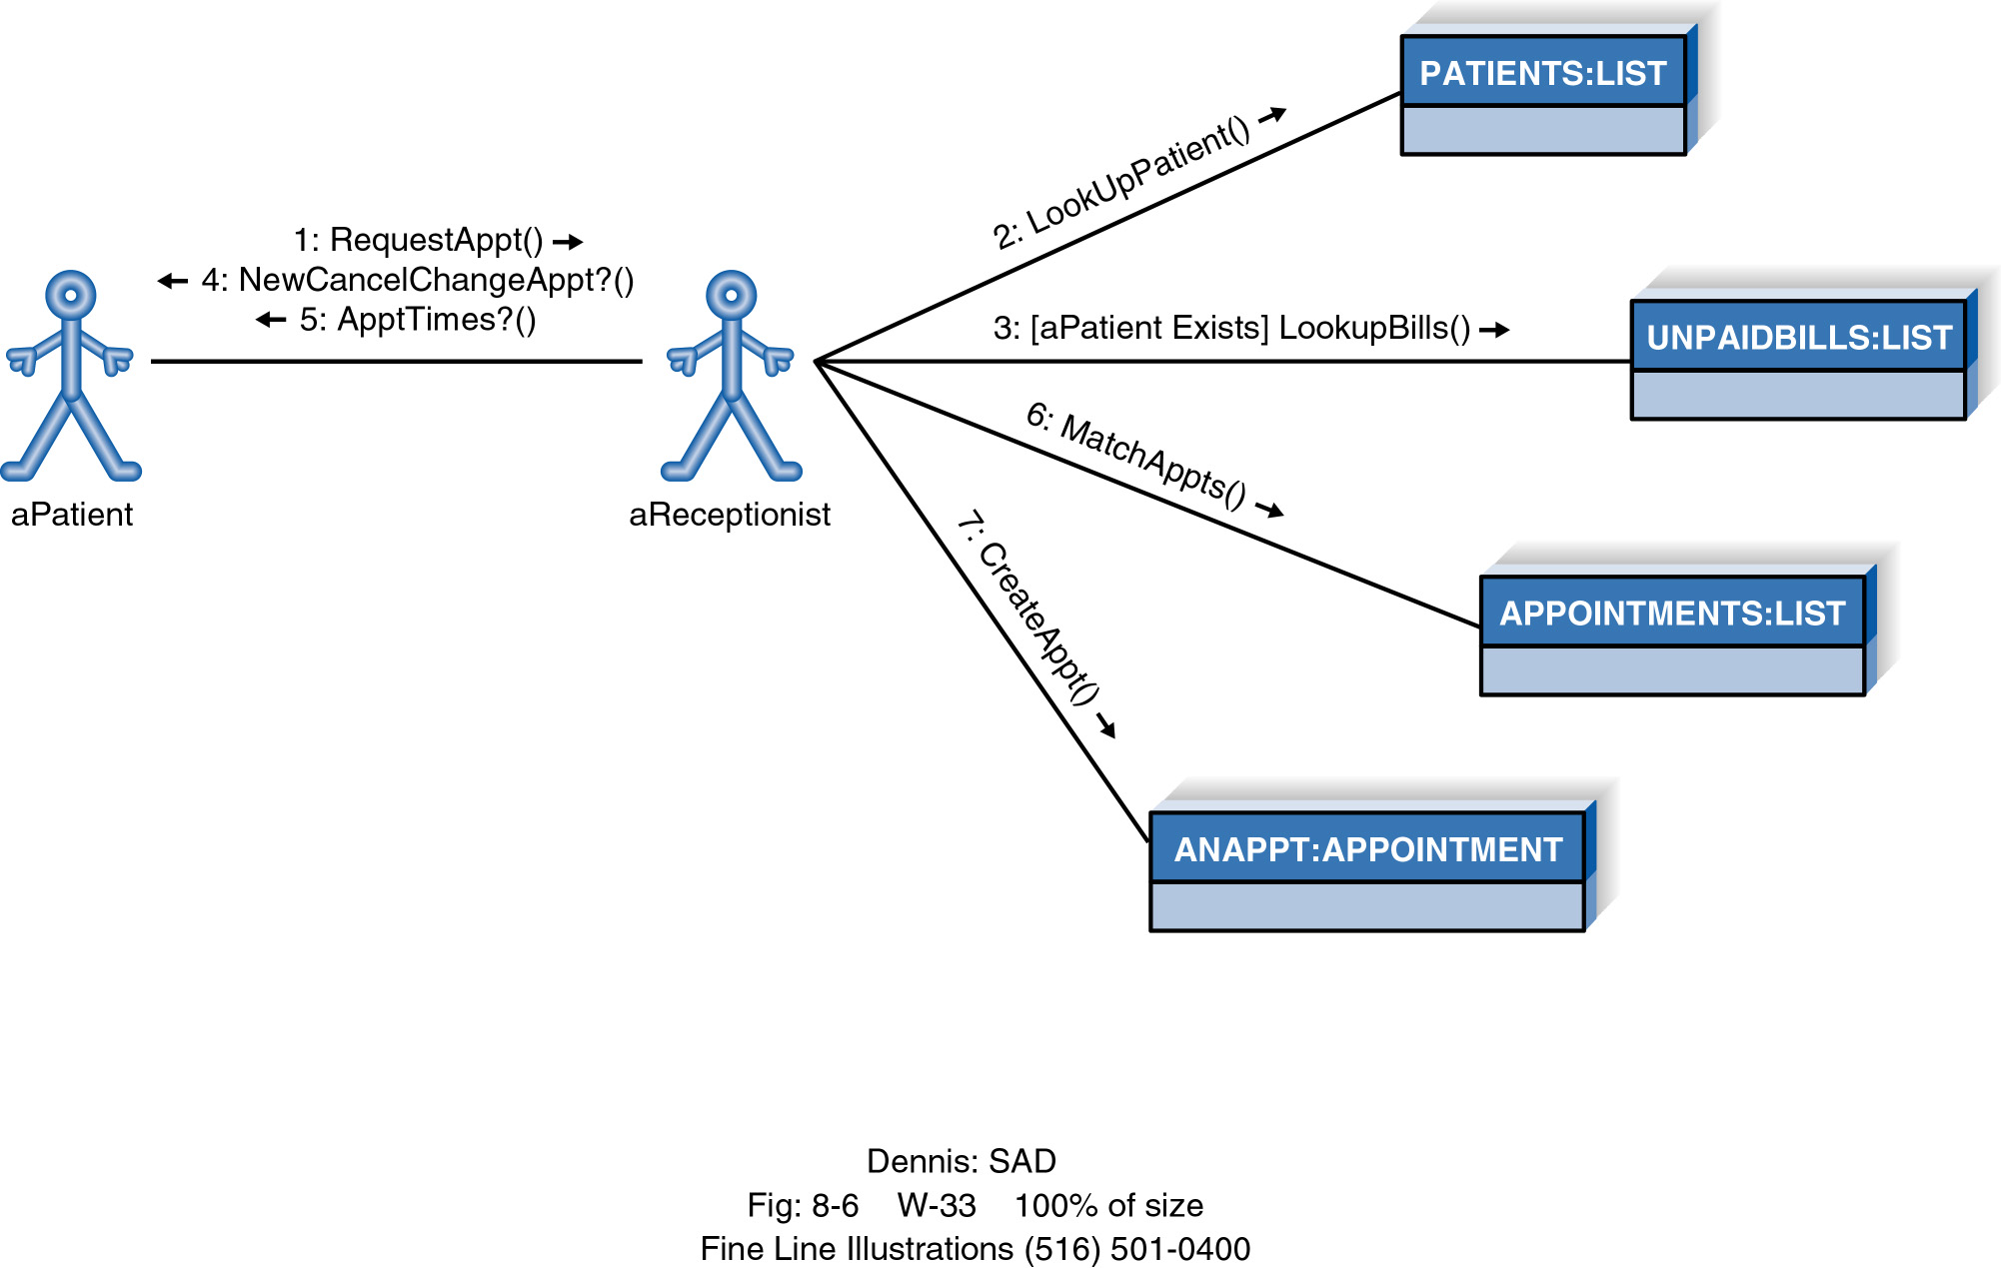
Example Collaboration Diagram

Slide 80
What is Software Architecture?
S0ftware architecture is the process of designing the global organization of a software system, including dividing software into subsystems, deciding how these will interact, and determining their interfaces.
The architect is the person in charge of the whole project.
He or she has the responsibility to make sure that the building will be solid, cost-effective and satisfactory to the client.

Slide 81
The importance of developing an architectural model
There are four main reasons why you need to develop an architectural model:
To enable everyone to better understand the system.
As a system becomes more and more complex, making it understandable is an increasing challenge.
This is especially true for large, distributed systems that use sophisticated technology.
To allow people to work on individual pieces of the system.
To prepare for extension of the system.
To facilitate reuse and reusability.
The architectural model makes each system component visible.
This is an important benefit since it encourages reuse.
By analyzing the architecture, you can discover those components that can be obtained from past projects or from third parties.

Slide 82
Contents of a good architectural model
A system’s architecture will often be expressed in terms of several different views.
These can include:
The logical breakdown into subsystems.
This is often shown using package diagrams
The interfaces among the subsystems must also be carefully described.
The dynamics of the interaction among components at run time,
Expressed using interaction or activity diagrams.
The data that will be shared among the subsystems
Expressed using class diagrams.
The components that will exist at run time, and the machines or devices on which they will be located.
This information can be expressed using component diagram.

Slide 83
Describing an architecture using UML
All UML diagrams can be useful to describe aspects of the architectural model.
Remember that the goal of architecture is to describe the system at a very high level, with emphasis on software components and their interfaces.
Three other types of UML diagram are particularly important for architecture modeling:
Component diagrams, Package diagrams and deployment diagrams.

Slide 84
Component Diagrams

Slide 85
Component Diagram
Shows a set of components and their relationships.
Represents the static implementation view of a system.
Node corresponds to component
A component is a set of classes with well-defined interfaces
Components map to one or more classes, interfaces, or collaborations.
Mapping of Components into Classes
Components and their Relationships
loanOfficer.dll
component
Registrar.exe
LoanOfficer
CreditSearch
Course.dll
LoanPolicy
Student.dll
classes

Slide 86
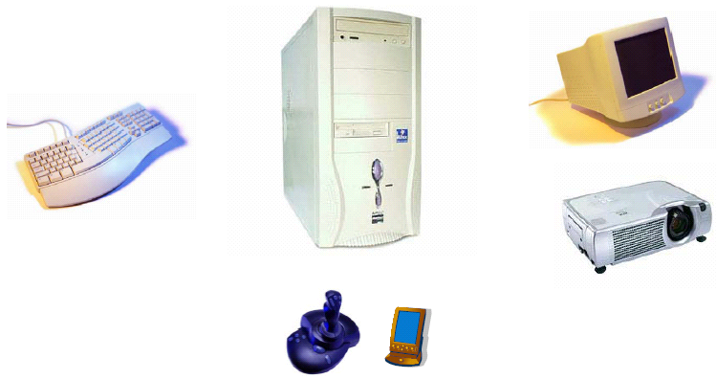
Component Diagram

Slide 87
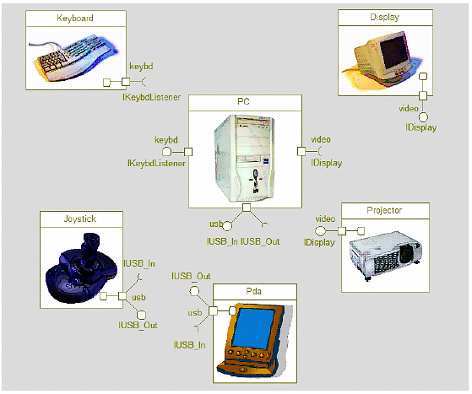
Component Diagram

Slide 88
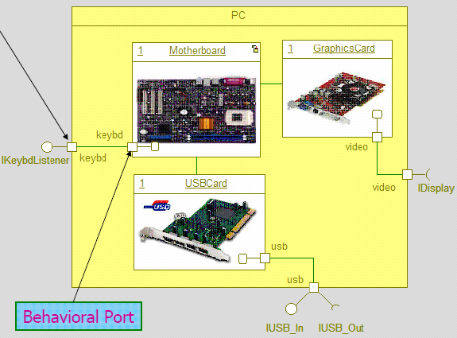
Component Diagram – another example

Slide 89
Component Diagram
Component
Explicit description of interfaces:
provided services to other components
requested services from other components
lollipop
Component
socket
An interface is a collection of 1..* methods, and 0..* attributes
Interfaces can consist of synchronous and / or asynchronous operations
A port (square) is an interaction point between the component and its environment.
Can be named; Can support uni-directional (either provide or require) or bi-directional (both provide and require) communication; Can support multiple interfaces.
possibly concurrent interactions
fully isolate an object’s internals from its environment
caller or callee?
security
AccessControl
StudentAdministration
Student
Encription
Incoming signals/calls
Persistence
Outgoing signals/calls
StudentSchedule
Data[1..*]
DataAccess

Slide 90
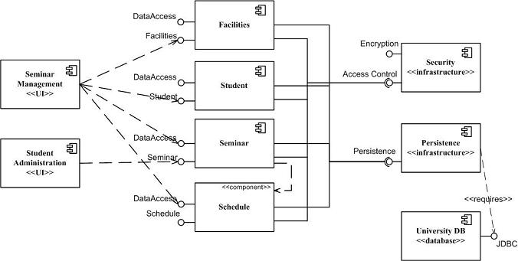
Component Diagram:

Slide 91
Component Diagram – Connector & Another Example
a connector: just a link between two or more connectable elements (e.g., ports or interfaces)
2 kinds of connectors: assembly and delegation. For “wiring”
An assembly connector: a binding between a provided interface and a required interface (or ports) that indicates that one component provides the services required by another; simple line/ball-and-socket/lollipop-socket notation
A delegation connector binds a component’s external behavior (as specified at a port) to an internal realization of that behavior by one of its parts (provide-provide, request-request).
delegation
delegation
assembly
connector
store
Left delegation: direction of arrowhead indicates
“provides”
So, what levels of abstractions for connections?
Right delegation: direction of arrowhead indicates
“requests”

Slide 92
Deployment Diagrams

Slide 93
Deployment Diagram
Static deployment view of a system
Physical allocation of components to a computational units
Node corresponds to computational unit(specific device)
Edge corresponds to communication
Shows a set of processing nodes and their relationships.
Represents the static deployment view of an architecture.
Nodes typically enclose one or more components.
TCP/IP
IIS + PhP Server
TCP/IP
J2EE Server
Membership Server
DecNet
Tomcat Server

Slide 94
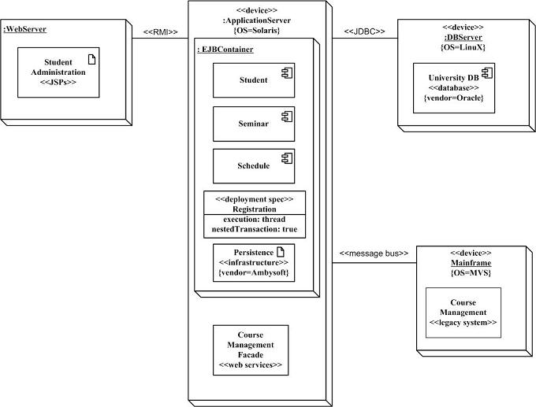
Structural Diagrams - Deployment Diagram
Student administration application
Physical nodes - stereotype device
WebServer - physical device or
software artifact
RMI/message bus: connection type
Nodes can contain other nodes
or software artifacts recursively
Deployment specs: configuration files:
name and properties

Slide 95
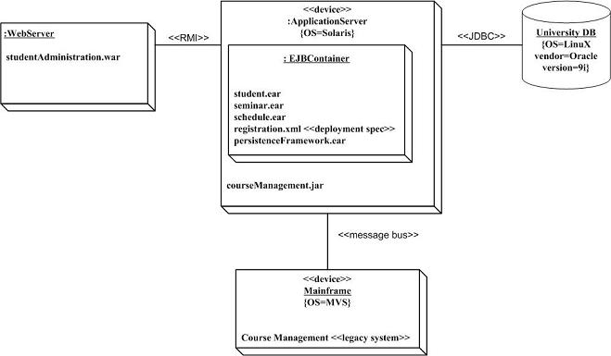
Structural Diagrams - Deployment Diagram
Is this better?
More concrete
Implementation-oriented

Slide 96
Package Diagrams

Slide 97
Packages
Package — general-purpose mechanism for organizing similar elements(classes) into groups.
Show Dependency among classes
Nested Elements: Composite relationship (When the whole dies, its parts die as well, but not necessarily vice versa)
(C++ namespace; specialization means “derived”)
simple names
path names
visibility
Client
Client
+ OrderForm
+OrderForm
-Order
enclosing package name
Business rules
+ TrackingForm
package name
- Order
Client
+TrackingForm
textual nesting
graphical nesting
Sensors::Vision
{ version = 2.24 }
Packages that are friends to another may see all the elements of that package, no matter what their visibility.
If an element is visible within a package, it is visible within all packages nested inside the package.
Visibility

Slide 98
Dependency –Among Packages
Two Stereotypes of Dependency Among Packages:
access: the source package is granted the right to reference the elements of the target package (:: convention)
import: a kind of access; the public contents of the target package enter the flat namespace of the source as if they had been declared in the source
Client
packageName
+ OrderForm
+ TrackingForm
- Order
<<import>>
<<access>>
exports
<<import>>
Policies
packageName
packageName
+OrderRules
-GUI::Window
imports
subPackageName
PackageClass
GUI
+Window
<<import>>
+Form
#EventHandler

Slide 99
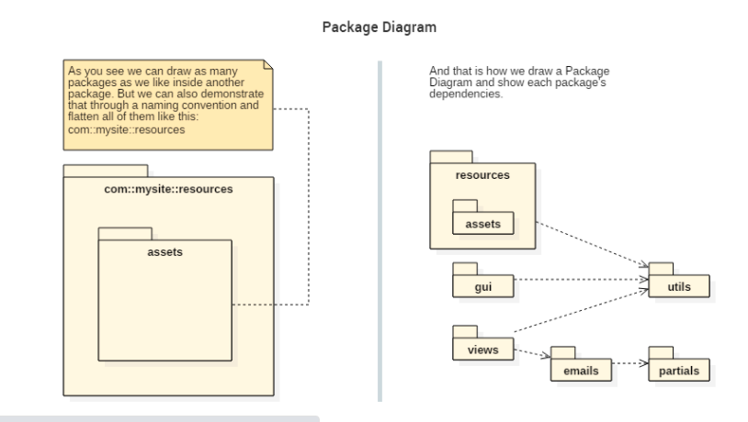
Dependency among packages

Slide 100
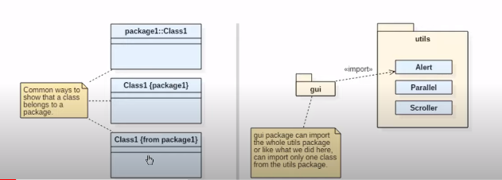
Dependency among packages

Slide 101
Architectural patterns
Software architecture is a pictorial representation of the IT system that communicates the following:
The organization of the system;
Different components with their functions;
How the components interact with each other.
The schematic representation is an outcome of the design principles software architects use and the decisions they make.
A typical software architecture requires decisions concerning security, performance, manageability, etc.
The Multi-Layer architectural pattern
The Client–Server and other distributed architectural patterns
The Broker architectural pattern
The Pipe-and-Filter architectural pattern
The Model–View–Controller (MVC) architectural pattern

Slide 102
Why Should You Focus on Software Architecture?
You need to get the software architecture right due to the following reasons:
A software development team makes the first set of decisions during the software architecture pattern selection.
Only the business requirements are available before this stage.
The first set of decisions are crucial in any project since sub-optimal decisions might result in budget and schedule overrun.
Your business stakeholders need to know about your progress.
Software architecture acts as a visual communication tool, therefore they can understand the system you are building.
Software architecture models make it easy to reuse them in other projects since you now know the decisions you made and the various trade-offs.

Slide 103
The Multi-Layer architectural pattern
In layered systems each layer communicates only with the layers below it
Each layer has a well-defined API, defining the services it provides
A complex system can be built by superimposing layers at increasing levels of abstraction.
The Multi-Layer architectural pattern makes it possible to replace a layer by an improved version
It’s one of the most commonly used patterns where the code is arranged in layers.

Slide 104
The Multi-Layer architectural pattern
Key characteristics of this pattern are as follows:
The outermost layer is where the data enters the system.
The data passes through the subsequent layers to reach the innermost layer, which is the database layer.
Simple implementations of this pattern have at least 3 layers, namely, a presentation layer, an application layer, and a data layer.
Users access the presentation layer using a GUI, whereas the application layer runs the business logic.
The data layer has a database for the storage and retrieval of data.
This pattern has the following advantages:
Maintaining the software is easy since the tiers are segregated.
Development teams find it easy to manage the software infrastructure, therefore, it’s easy to develop large-scale web and cloud-hosted apps.

Slide 105
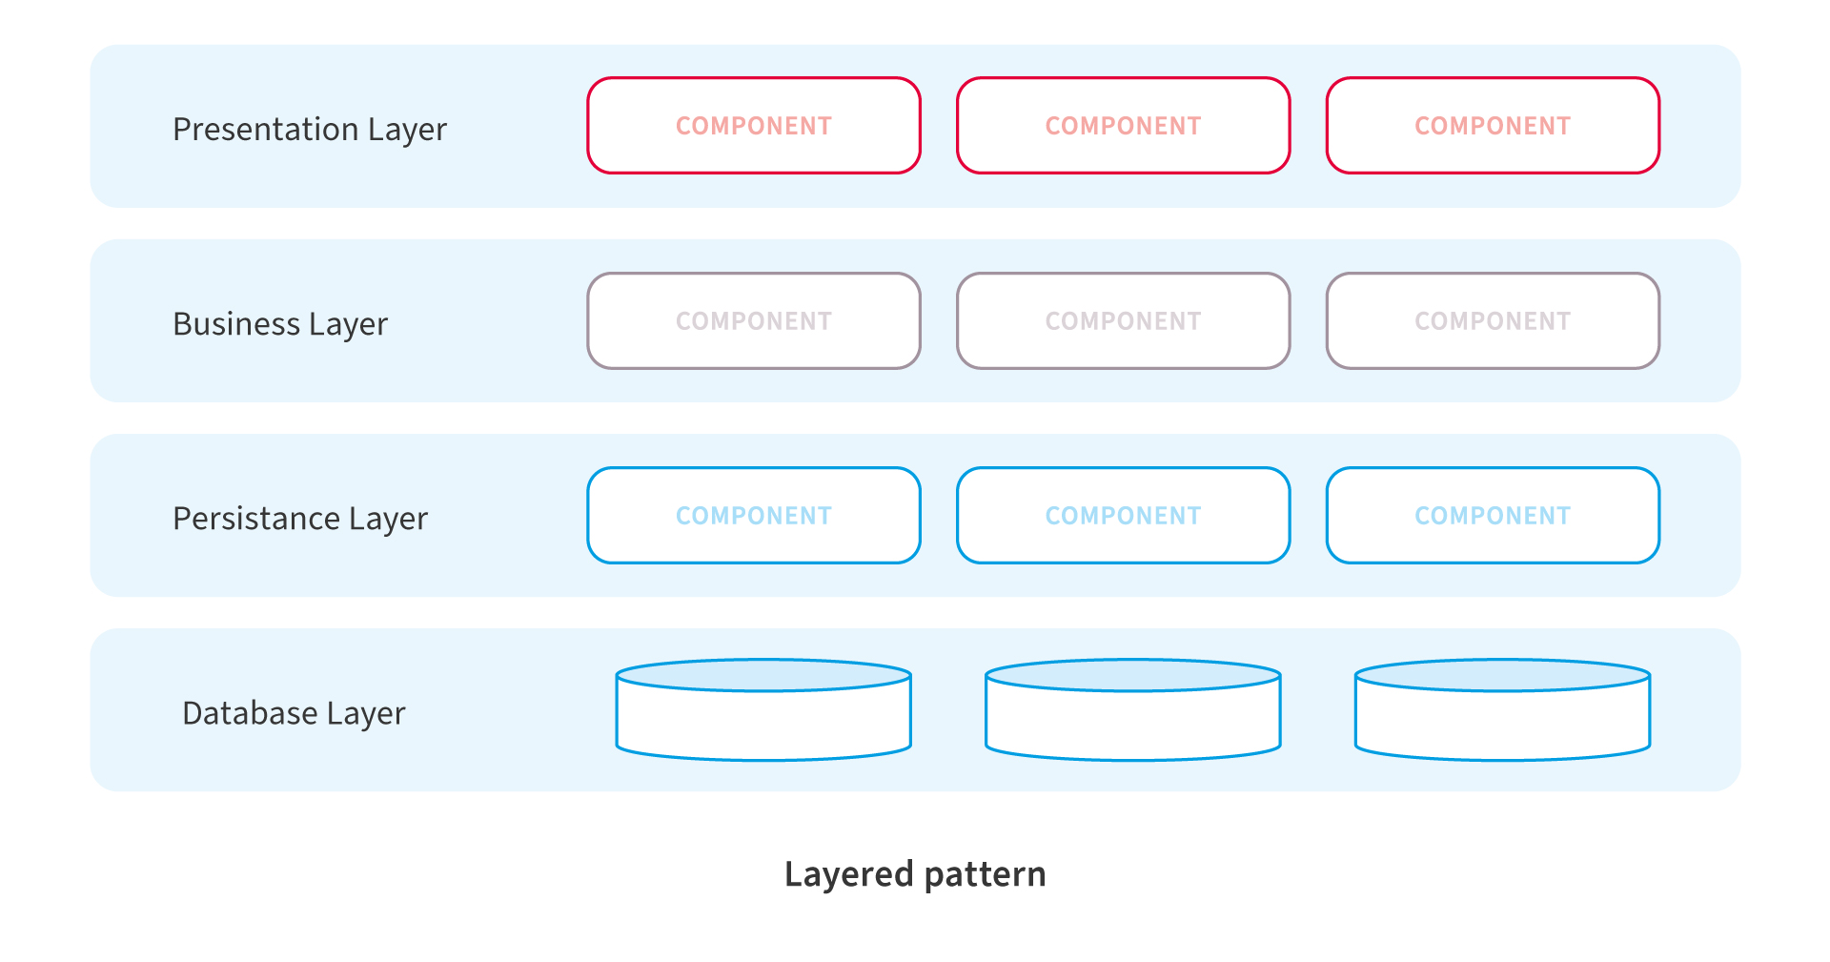
The Multi-Layer architectural pattern

Slide 106
The Client–Server and other distributed architectural patterns
Is another commonly used one, where there are 2 entities.
It has a set of clients and a server.
The following are key characteristics of this pattern:
Client components send requests to the server, which processes them and responds back.
When a server accepts a request from a client, it opens a connection with the client over a specific protocol.
Servers can be stateful or stateless.
A stateful server can receive multiple requests from clients.
It maintains a record of requests from the client, and this record is called a ‘session’.

Slide 107
The Client–Server and other distributed architectural patterns
Email applications are good examples of this pattern.
The pattern has several advantages, as follows:
Clients access data from a server using authorized access, which improves the sharing of data.
Accessing a service is via a ‘user interface’ (UI), therefore, there’s no need to run terminal sessions or command prompts.
Client-server applications can be built irrespective of the platform or technology stack.
This is a distributed model with specific responsibilities for each component, which makes maintenance easier.

Slide 108
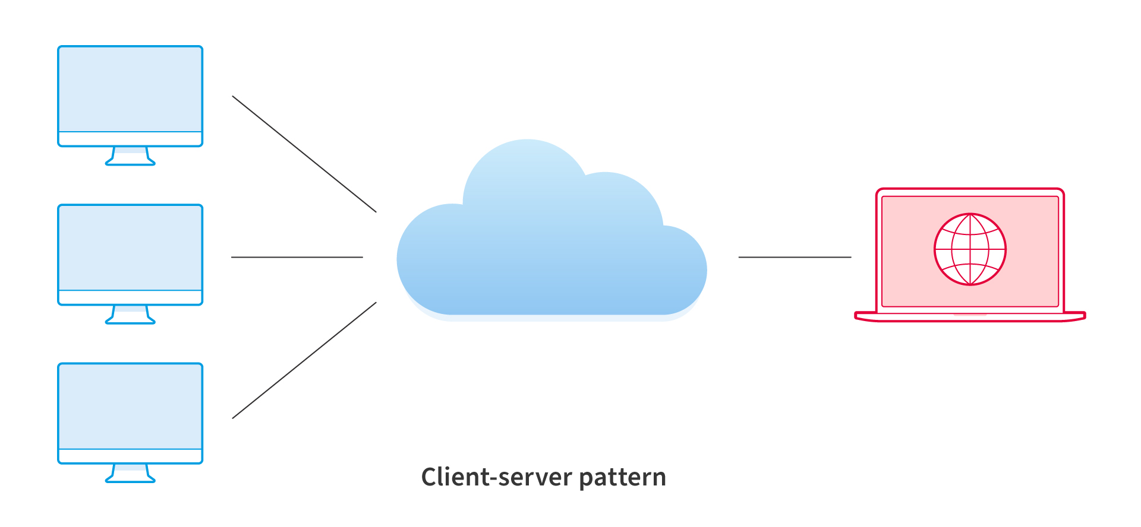
The Client–Server and other distributed architectural patterns

Slide 109
The Broker architectural pattern
Consider distributed systems with components that provide different services independent of each other.
Independent components could be heterogeneous systems on different servers, however, clients still need their requests serviced.
“Broker architecture pattern” is a solution to this.
It has the following broad characteristics:
A broker component coordinates requests and responses between clients and servers.
The broker has the details of the servers and the individual services they provide.
The main components of the broker architectural pattern are clients, servers, and brokers.
It also has bridges and proxies for clients and servers.
Clients send requests, and the broker finds the right server to route the request to. It also sends the responses back to the clients.

Slide 110
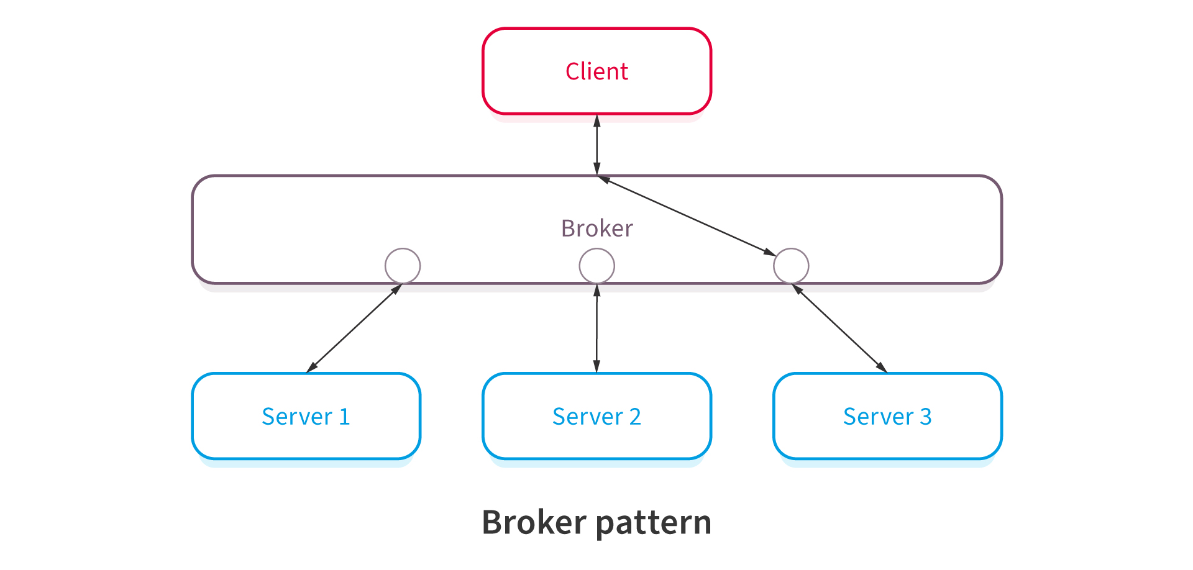
The Broker architectural pattern

Slide 111
The Model–View–Controller (MVC) architectural pattern
This pattern is popular and involves separating an applications’ data model, presentation layer, and control aspects.
Following are its’ characteristics:
There are three building blocks here, namely, model, view, and controller.
The application data resides in the model.
Users see the application data through the view, however, the view can’t influence what the user will do with the data.
The controller is the building block between the model and the view.
View triggers events, subsequently, the controller acts on it.
The action is typically a method call to the model.
The response is shown in the view.
Its’ advantages:
Using this model expedites the development.
Development teams can present multiple views to users.
Changes to the UI is common in web applications, however, the MVC pattern doesn’t need changes for it.
The model doesn’t format data before presenting to users, therefore, you can use this pattern with any interface.

Slide 112
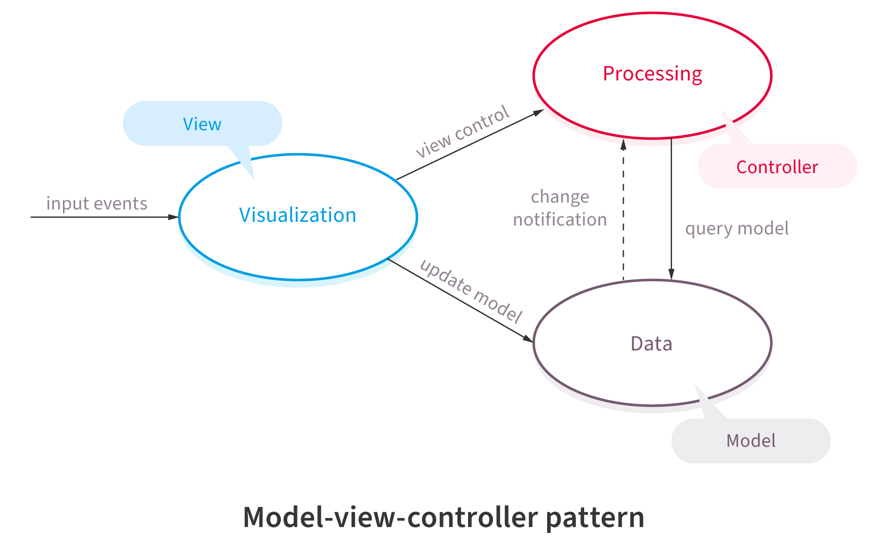
The Model–View–Controller (MVC) architectural pattern

Slide 113
The Pipe-and-Filter architectural pattern
Suppose you have complex processing in hand.
You will likely break it down into separate tasks and process them separately.
This is where the “Pipe-filter” architecture pattern comes in use.
Following characteristics distinguish it:
The code for each task is relatively small. You treat it as one independent ‘filter’.
You can deploy, maintain, scale, and reuse code in each filter.
The stream of data that each filter processes pass through ‘pipes’.
Compilers often use this pattern, due to the following advantages:
There are repetitive steps such as reading the source code, parsing, generating code, etc. These can be easily organized as separate filters.
Each filter can perform its’ processing in parallel if the data input is arranged as streams using pipes.
It’s a resilient model since the pipeline can reschedule the work and assign to another instance of that filter.

Slide 114
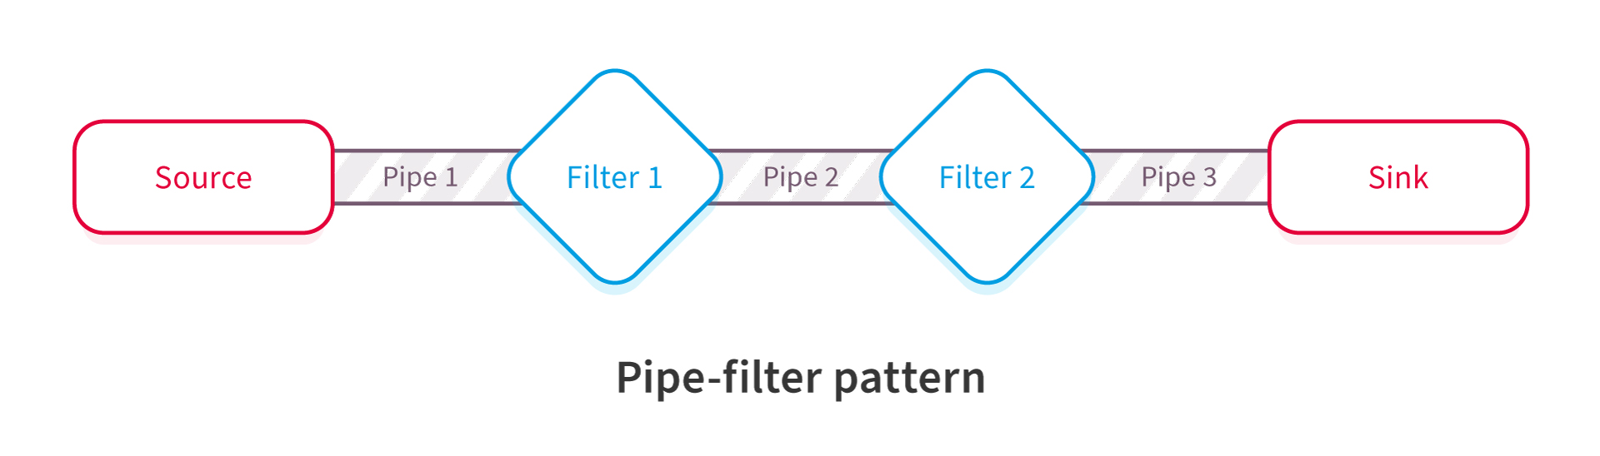
The Pipe-and-Filter architectural pattern

Slide 115
END

